Slide 1



Creating Graphical User Interface
(GUI & Swing, Part 2)
Events in Java
How to Use Menu
References:
Textbook, chapter 11
Java-Tutorials/tutorial-2015/uiswing/index.html

Slide 2
Contents
Events in Java
Working with Menu
Demonstrations

Slide 3
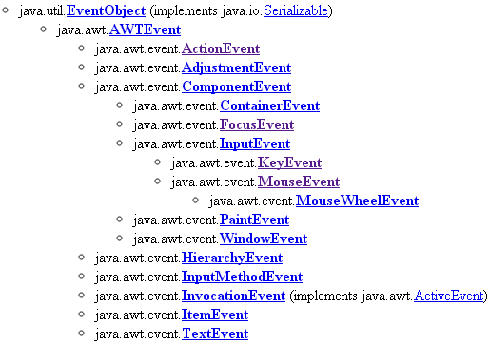
1- Events in Java
2 types of events:
  Low-level events: FocusEvent, KeyEvent
  High-level events: ActionEvent, ItemEvent
Refer to the java.awt.event package for more details.

Slide 4
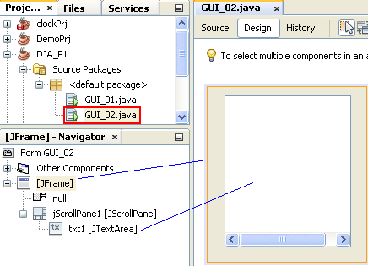
Demo 2 - 1: Window Events
This demonstration will help you exploring events on the window (Frame)
Design
Frame Properties:
Layout: null
Title: GUI_02 Demo

Slide 5
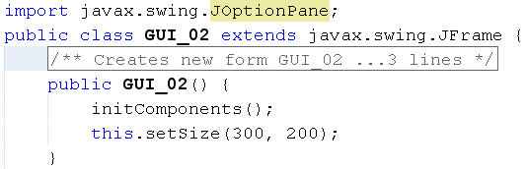
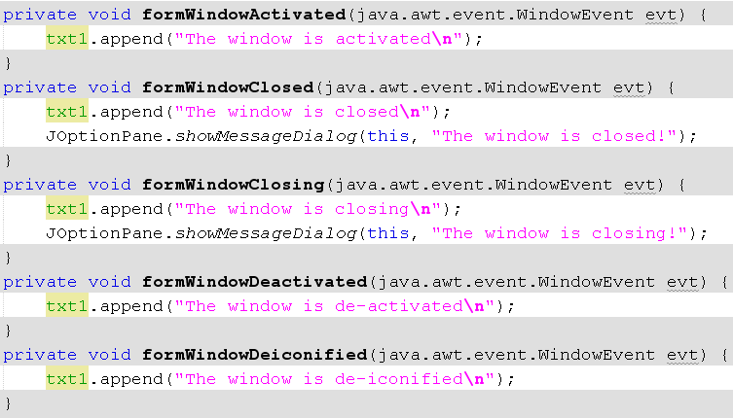
Demo 2 - 2: Window Events

Slide 6
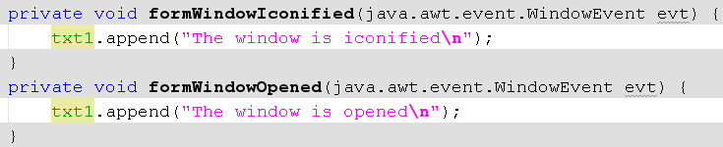
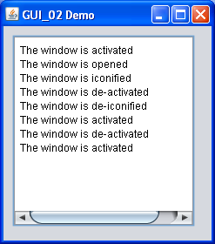
Demo 2- 3: Window Events
Run the program:
Use the mouse, you will activate/iconify/de-iconify/close the program. You will see results presented in the textarea when the window (frame) is impacted.
Questions:
Give your opinion about window events.

Slide 7
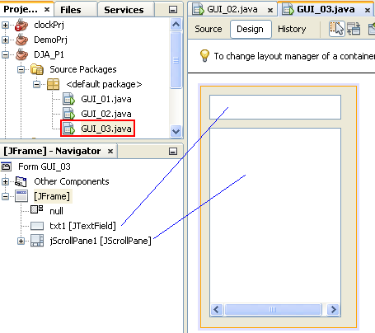
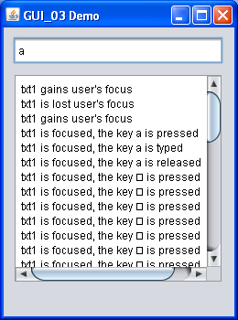
Demo 3 - 1: Low Level Events
Frame Properties:
Layout: null
Title: GUI_03 Demo
After you complete code, run the program. Click the mouse on textbox and/or textarea, press some key on the keyboard. The result will like as the GUI in this slide
Questions:
Give your opinion about low-level events.

Slide 8

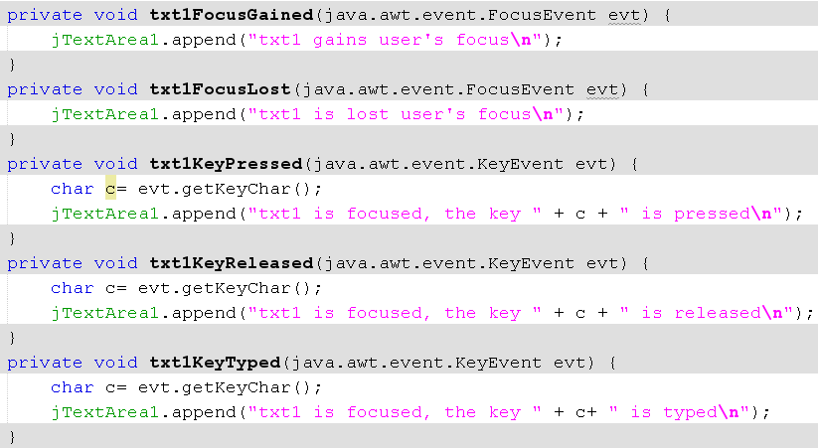
Demo 3 - 2: Low Level Events

Slide 9
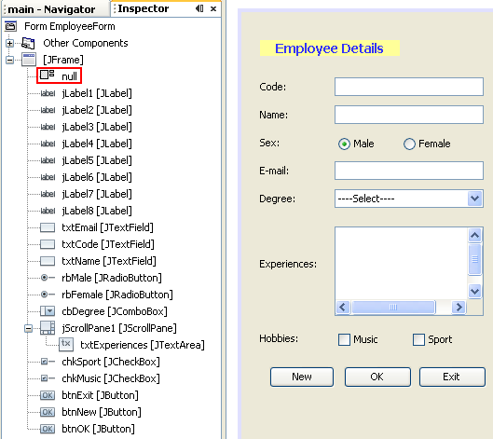
Demo 4 - 1: Ordinary Components
Application for managing employees

Slide 10
Demo 4 - 2: Ordinary Components…

Slide 11
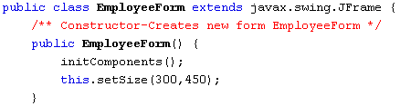

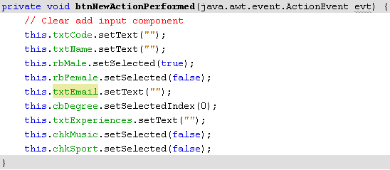
Demo 4 - 3: Ordinary Components…

Slide 12
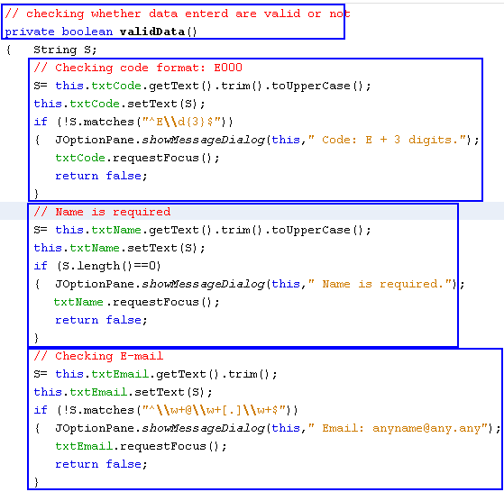
Demo 4 - 4: Ordinary Components…

Slide 13
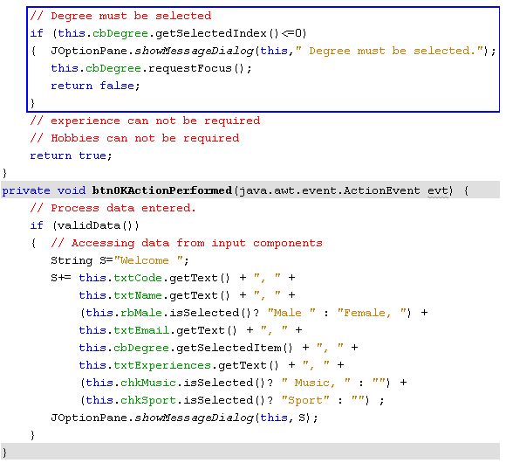
Demo 4 - 5: Ordinary Components…

Slide 14
2- Menu
Menu is a mean which allows user choose an function of a program at a time
Main characteristic of menu: It needs not to be supply a wide screen area
A menu should be created if the program supporting a lot of operations but we do not want to pay more screen area.

Slide 15
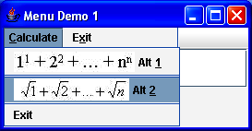
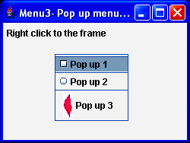
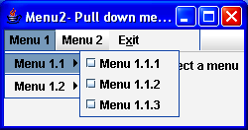
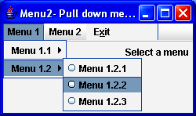
Menu…
JMenuBar
JMenuItem
JPopUpMenu
JMenu
JCheckBoxMenuItem
JRadioButtonMenuItem
JSeparator
Menu Organization

Slide 16
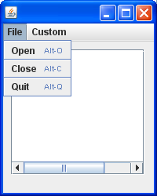
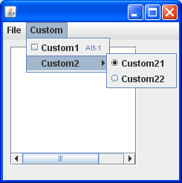
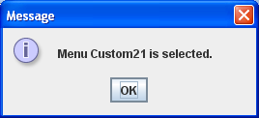
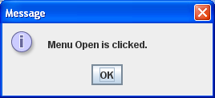
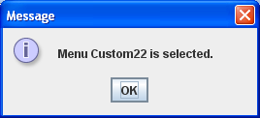
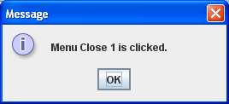
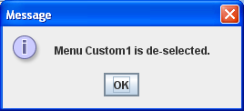
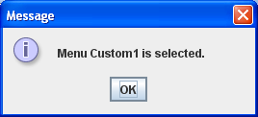
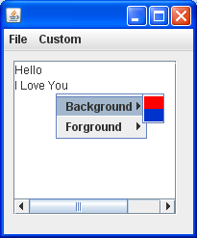
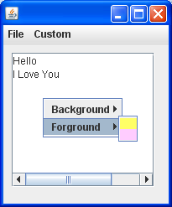
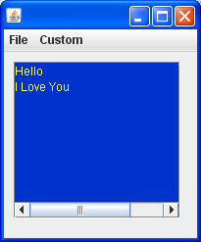
Demo 5 - 1: Menu

Slide 17
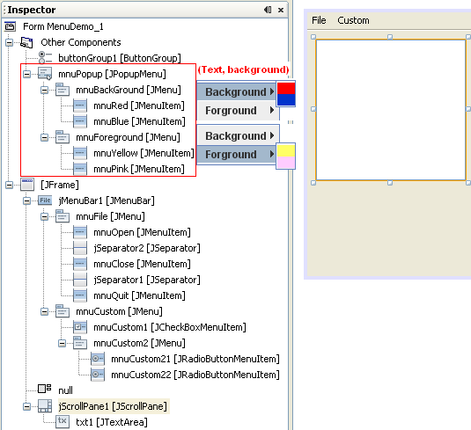


Demo 5 - 2: Menu…

Slide 18
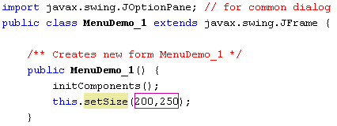




Demo 5 - 3: Menu

Slide 19
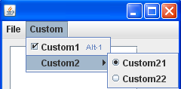
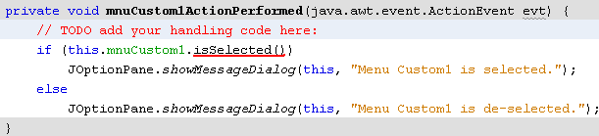
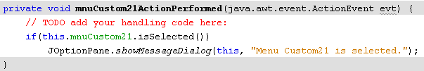

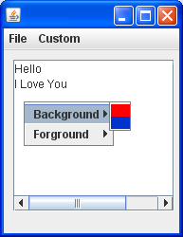


Demo 5 - 4: Menu…

Slide 20
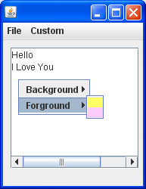
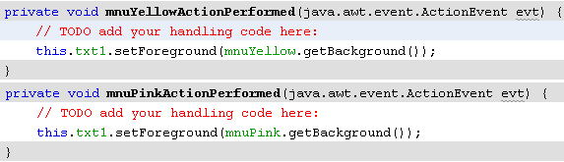
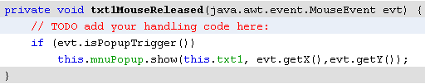
Demo 5 - 5: menu…

Slide 21
Summary
Events in Java
Working with Menu
Demonstrations

